Slide 1
OCCUPATIONAL SAFETY AND HEALTH
Track 2: Module 13
Duration: 1hr
Notes:
Introduce instructor (self).

Slide 2
Session content outline
Learning objectives
Content
Introduction
Definition of occupational Safety and Health
Importance of an occupational health and safety program
Commonly encountered Occupational hazards in health facilities
The chain of infection
Mode of transmission of infectious agents among HCW
Prevention of occupational exposures using a hierarchy of controls
Preventive and control measures for work related exposures
Occupational Health and Safety programs
Assessment
Summary
References
Notes:
Introduce the session content outline.

Slide 3
Learning objectives
By the end of this session, learners should be able to:
Skill objectives | Safeguard against work related hazards Identify hazards associated with specific work activities Apply preventive measures for work related exposures
Attitude objective | Appreciate the importance of Occupational Safety and Health in facilities for the attainment of the highest level of health and safety of all workers.
Knowledge objectives: | Define Occupational Safety and Health Explain the importance of having occupational health and safety program at the work places/facilities Describe Commonly encountered Occupational hazards in health facilities with examples Discuss the prevention of occupational exposures using a hierarchy of controls Explain preventive and control measures for work related exposures Explain the major elements of an occupational safety and health program
Notes:
Inform learners of the objectives

Slide 4
INTRODUCTION
OSH is a mechanism for recording and reporting occupational illnesses, injury, adverse incident and consequential actions.
Employers should promote a safe work environment by eliminating occupational factors and conditions hazardous to health and safety at workers, as well as encourage workers to report incidents and accidents
It is the responsibility of the employee to report any unsafe working conditions and any accident or incident involving hazards

Slide 5
INTRODUCTION
A healthy and safe working environment is important for physical, mental and social well-being of all health workers.
Health and safety of health workers are also important for the quality of care, patient safety and prevention of infections in healthcare facilities.
Requires employer and worker collaboration

Slide 6
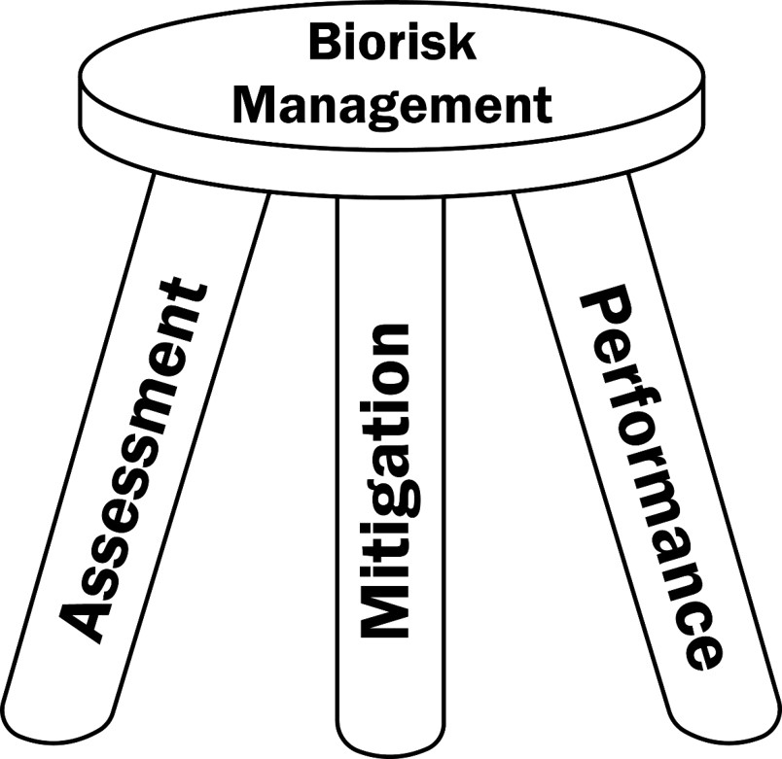
THE AMP Model

Slide 7
Definition
Occupational health is the promotion and maintenance of the highest degree of physical, mental and social well-being of workers in all occupations.
The protection of workers in their employment from risks resulting from factors adverse to health in the course of work.

Slide 8
Occupational Health and Safety programs
An effective occupational safety and health program includes the following four elements:
Management commitment and employee involvement
Hazard/Risk Assessment
Hazard prevention and control
Safety and health training

Slide 9
Importance of occupational health and safety programs
To protect health, safety and well-being of workers and people at work through:
Primary prevention and control of occupational hazards
Monitoring the health of workers in relation to their work
promoting healthy behaviors, physical and mental well-being among workers.
Improvement of working environment
Development of work cultures and organizations to support health and safety
Promotion of positive social climate and smooth work operation
Enhanced productivity of the organization.

Slide 10
Commonly encountered Occupational hazards in health facilities
BIOHAZARDS
Bacteria, viruses, fungi, or parasites, that may be transmitted by contact with infected patients, contaminated body secretions/fluids, blood, sputum, etc.
HAZARDOUS CHEMICALS
Various forms of chemicals that are potentially toxic or irritating to the body.
For example: disinfectants, medications, mercury and anaesthetic gases.

Slide 11
Commonly encountered Occupational hazards in health facilities
PSYCHOSOCIAL
Factors of work organization and interpersonal relations
Example: job content, workload, conflicts, harassment, violence, stigma and discrimination..
PHYSICAL HAZARDS
Physical factors within the work environment that can harm health.
Example: noise, ionizing radiation, heat or cold, accidents, and manual handling of loads.

Slide 12
The chain of infection
Certain conditions must be met in order for a microbe or infectious disease to be spread from host to host (animal to animal, animal to human, human to human or human to animal).
This process is called the chain of infection
There six links in the chain of infection;
Causative agents
Reservoir
Portal of exit
Mode of transmission
Portal of entry
susceptible host
Notes:
Infection Control principles are aimed at breaking one or more links in the chain.
Causative Agent - the microorganism (for example bacteria, virus or fungi).
Reservoir (source) - a host which allows the microorganism to live, and possibly grow, and multiply. Humans, animals and the environment can all be reservoirs for microorganisms.
Portal of Exit - a path for the microorganism to escape from the host. The blood, respiratory tract, skin and mucous membranes, genitourinary tract, gastrointestinal tract, and transplacental route from mother to her unborn infant are some examples.
Mode of Transmission - since microorganisms cannot travel on their own; they require a vehicle to carry them to other people and places.
Portal of Entry - a path for the microorganism to get into a new host, similar to the portal of exit.
Susceptible Host - a person susceptible to the microorganism.

Slide 13
Chain of Infection and hierarchy of infection
Substitution
Reservoir of pathogen
Portal of escape
Transmission
Route of entry/infectious dose
Susceptible host
Incubation period
Illness
Proper Work Practices
Engineering Controls & Protective Equipment
Immunization
Risk Assessment
Surveillance
Notes:
The term "containment" is used in describing safe methods for managing infectious materials in the laboratory environment where they are being handled or maintained. The purpose of containment is to reduce or eliminate exposure of laboratory workers, other persons, and the outside environment to potentially hazardous agents. Primary containment, the protection of personnel and the immediate laboratory environment from exposure to infectious agents, is provided by both good microbiological technique and the use of appropriate safety equipment. The use of vaccines may provide an increased level of personal protection. Secondary containment, the protection of the environment external to the laboratory from exposure to infectious materials, is provided by a combination of facility design and operational practices. Therefore, the three elements of containment include laboratory practice and technique, safety equipment, and facility design. The risk assessment of the work to be done with a specific agent will determine the appropriate combination of these elements.

Slide 14
Mode of transmission of infectious agents among HCW
Aerosols : Airborne particles (measles, tuberculosis) or respiratory droplets (acute respiratory infections; COVID-19, influenza, meningococcal meningitis)
Blood and body secretions/fluids: HIV/AIDS, Hepatitis B and C, haemorrhagic fevers (Ebola, Lassa)
Direct contact with patients and contaminated objects: respiratory infections, haemorrhagic fevers, cholera, typhoid
Vectors (such as mosquitos) – malaria, dengue, yellow fever.

Slide 15
Prevention of occupational exposures using a hierarchy of controls
Elimination/Substitution: substituting jet injectors for needles and syringes or using needleless IV systems, substitute powdered gloves with powder fee gloves
Engineering controls : safe needle devices, radiation shields
Administrative controls: access control, training on health & safety, limit exposure to the hazard
Work practice controls: hand hygiene, no needle recapping, placing sharps containers at eye level
Personal protective equipment : barriers and filters between the worker and the hazard. Gloves, eye goggles, masks and gowns

Slide 16
Preventive and control measures for work related exposures
Vaccination: ( ISO 35001 : 7.1.1.1), 15190 : 5.4.2
The organization should establish and implement vaccination policy as part of worker health program.
Ensure that the recommended /required vaccines and information are made available to workers
Maintain immunization records in accordance with national, organizational and local requirements
Ensure access to work areas and activities is controlled for individuals and visitors (students) in accordance with the organization’s vaccine policy

Slide 17
Preventive and control measures for work related exposures
Psychological Hazards ( ISO 15190 : 5.4.3)
- General (5.4.3.1)– Management take responsibility and action to reduce organizational, environmental and personal factors that contribute to excessive stress. (Note 1 and note 2)
- Organizational Factors (5.4.3.2) – management to take responsibility and action to reduce these factors: - (effective communication strategies, task and schedule design, workload assessment and redistribution)
- Environmental Stressors (5.4.3.3) – self-renewal activities (vacations, team building), counseling, physian prescribed treatment) etc.
Employee Impairment ( 5.4.4)

Slide 18
Preventive and control measures for work related exposures
Injury and adverse incidents recording and reporting
Managers and supervisors should support workers to report and document all work related exposures and incidents for easy follow up and mitigation.
There should be mechanisms for recording and reporting occupational illnesses, injury adverse incidents, and consequential actions , while at the same time respecting confidentiality of individuals – (ISO 15190 : 5.8.1)

Slide 19
Preventive and control measures for work related exposures
Medical surveillance programs ( 35001 : 7.1.1)
The organization should ensure that risks to worker health are managed effectively including considerations for preventive and protective measures.
All workers whose health could be directly impacted by exposure to biological materials shall be included in the worker health program

Slide 20
Preventive and control measures for work related exposures
Enhance Post-exposure and emergency procedures
Develop post-exposure plan
First-aid protocols (Location of first-aid kit; stocking)
Initial medical services (who will provide)
e.g. On-site Health facilities/ emergency care
Hazard awareness
hazard information or card for presentation to medical staff or attending clinician
Follow-up medical services
Are contracts in place for follow-up care & services?

Slide 21
Preventive and control measures for work related exposures
Environmental control and surveillance services
should be provided to detect, avoid, or limit harmful occupational exposures.
Special attention should be given to hazardous occupational exposures;
e.g. for women of childbearing age
to employees exposed to ionizing or non-ionizing radiation
to operating room personnel exposed to anaesthetic gases.

Slide 22
Preventive and control measures for work related exposures
Pre-placement medical history
Evaluation of past medical history for new employees:
Medical, surgical, social and family history
Allergies and sensitivities (latex, drugs, foods)
Previous occupational history and activity
Medications and other treatments
Active conditions and review of major body systems
Review and record past immunization history.

Slide 23
Preventive and control measures for work related exposures
Health status and job selection
Review of job description (JD):
Review the prescribed job description against candidate’s physical status.
Assess capability of the person to perform.
Based on this accept candidate or recommend re-deployment to a suitable position.
Baseline serologic testing; for documentation.
Routine medical evaluations targeted to job (e.g., respirator usage), prolonged exposure of certain toxins,
Work-specific, Species-specific, Agent-specific, Method-specific

Slide 24
Preventive and control measures for work related exposures
Previous occupational history and immunization
The previous occupational activities could have exposed you to certain infection. (e.g. TB ).
Each worker’s immunization history should be evaluated for: completeness and currency at the time of employment
Re-evaluated when the individual is assigned job responsibilities with a new biohazard.
Health workers who are exposed to blood borne pathogens should be immunized against Hepatitis B.

Slide 25
Preventive and control measures for work related exposures
Periodic health maintenance procedures
should include a general examination to assess continued job compatibility, and special appraisals necessitated by extensive illness or job changes
Can also be done due to changes in work procedures or techniques

Slide 26
Preventive and control measures for work related exposures
Provisions for care of illness and injury at work
should include arrangements for medical, surgical, psychological, and rehabilitative services
specific location availability of competent medical personnel, and a formalized procedure should be maintained.
Treatment and reports of occupational injuries and illnesses should conform to state compensation laws and OSHA requirements.
e.g. Uganda Work’s Compensation act of 2000
Permanent total incapacity - Amount equal to 60 month’s earnings
Temporary incapacity – determined by court

Slide 27
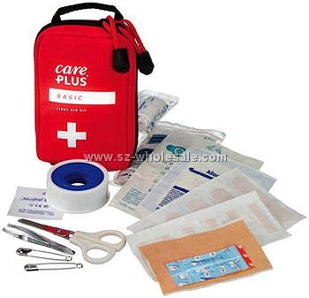
Occupational Health and Safety programs
Safety training and orientation
Scope of personnel training;
Managers/supervisors should ensure specific and appropriate safety training programs are implemented to safe guard workers against work related exposures
Safety training program
Fire prevention and Control training
First aid training
On job or task specific

Slide 28
Assessment
Define the term Occupational Safety and Health program.
Classify the different work related hazards in the facility of your choice.
Explain the preventive and control measures for work related exposures.
Which four elements constitute an effective Occupational Safety and Health program?
Notes:
Take class through these questions to ensure understanding

Slide 29
Summary
An effective worker safety and health programs involves:
Reducing work related injuries and illnesses.
Improving morale and productivity of personnel.
Meeting staff compensation costs.
Four critical elements to be adhered to management commitment and employee involvement; conducting risk assessment; hazard prevention and control; and safety and health training.
Notes:
The employers’ roles in meeting staff compensation cost should be clear for the particular institutional employment policies
The employees should be educated on the procedures required in claiming for compensation.

Slide 30
Action Plan
In the table below indicate the course of action you will take at your workplace regarding what you have learnt in this session
What will I do ? | How will I do it? | Indicator | Timeline
Identify the potential hazards | By carrying out technical audits of the workplace | Number of potential hazards identified | Immediately
Train workers on OSH | Through simulation exercises | No of trainings conducted
Notes:
Expected answers from participants
Writing SoPs for First Aid in case of the different mishaps in the laboratory
2. Undertake drills to administer First Aid
3. Actively enroll into Worker Health Schemes
4. Training in occupational health hazards
5. Acquire all copies of relevant acts that protects the employees e.g. OSH act 2006; employment act and agricultural chemical act

Slide 31
References
ISO 35001
ISO 15190
CDC: Power point presentations for ACILT Johannesburg Biosafety and Biosecurity training, November 2010

Slide 32
THANKS
Notes:
Evaluation
Ask students to complete the course evaluation and to put it in the evaluation box (alternately, give students instructions for completing the evaluation on-line).

